Slide 1

SDD of Payroll Management System
Submitted By:- Submitted to:-
Saloni Jaiswal Dr. Shaligram Prajapat Sir
IT-2k19-50
M.Tech (IT)

Slide 2
INTRODUCTION In the era of all-modern today technology is becoming increasingly sophisticated. The use of computers is one of the most important things in the life of the community extensively, not only in the world of work, health and government, but also in everyday life. The application of computer-based information becomes an absolute necessity and can provide a competitive advantage so that it gets high priority on corporate, hospital, or government environments. Therefore, the use of computers is very important especially for data processing, thus minimizing the error rate in inputting data or making reports. A company needs a system that can assist the work in processing employee payroll data. Actually, the company has been utilizing IT in performing payroll data processing employees, but the company is still not maximized in utilizing the IT media. The process runs from employee payroll system in the company by utilizing Microsoft Excel in data processing employees. Therefore in this study proposes to build model of employee payroll system integrated with employee absenteeism, so that later will easily get report about employee salary status.

Slide 3
METHOD Here is a system running on the company XYZ: (1). the absentee calculation process, every day the employee fills in the attendance list of the employee who subsequently corrected the financial section, attendance list of the absent employees due to illness, permission, leave, alpha, (2) salary calculation process, in this process the finance section takes the employee attendance register file, employee records, and allowances and deductions to be processed as inputs in salary calculations and outputs in the form of payrolls stored in the payroll file and (3). the process of making the report, in this process the financial section to take a salary file containing a payroll to be made a report that will be submitted to the leadership of the company. From the system running, then made a proposal system about the payroll system employees who are more utilizing the IT media. Proposed system created, there are actors involved in the system, such as employees, leaders, admin and super admin. They have different tasks, such as: super admin has the task of managing all the content or the contents that exist in the system, the admin can manage the existing content in the system,

Slide 4
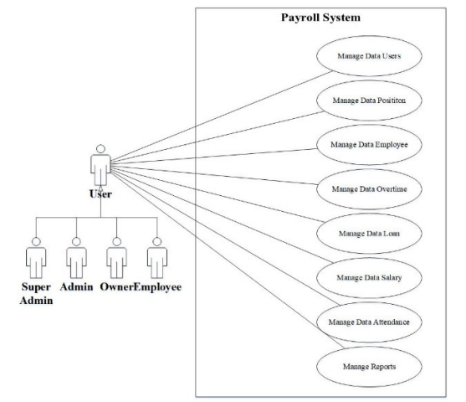
but cannot manage in addition to wanting deletion of user data , all done by super admin , the owner or the leader can only view the reports displayed in the system and the employee can see information about the attendance. The description of the proposed system can be seen in the use case diagram in Fig. . Fig 1. Use case diagram payroll system

Slide 5
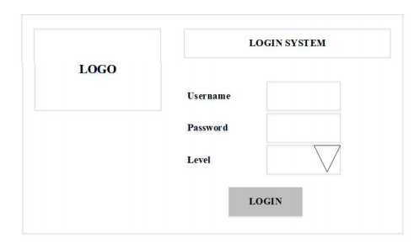
LT AND DISCUSSION After the analysis, then this is the stage to see the results in accordance with the analysis made in accordance with the needs. Fig 2. Form login users In the picture above explains that, all users before entering into the system must login first by entering the username and password, if the username and password are correct, then users will enter into the system according to the activity.

Slide 6
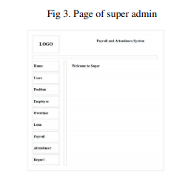
In the picture above, super admin has to login and succeed. In the page for super admin there is some content that can be used such as organize all activities.

Slide 7
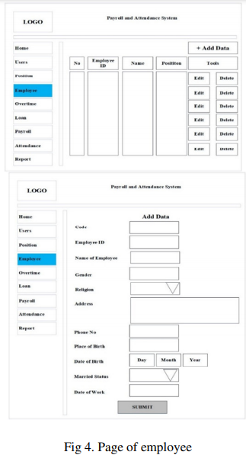
In the picture below, admin can process employee data by entering employee data, change employee data and delete employee data.

Slide 8
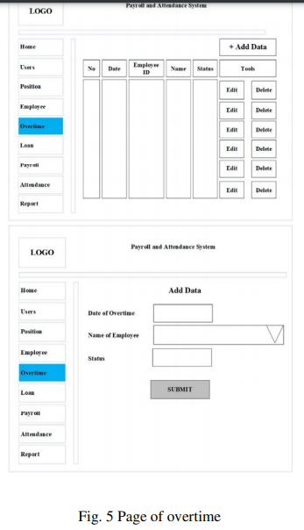
In the view can be explained that the admin can manage employee overtime data, so that on the payroll process employees will get a salary according to what has been done. If employees often get or do work overtime, then the employee's income will be greater, but if employees do not do overtime, then the income is also not too much.

Slide 9
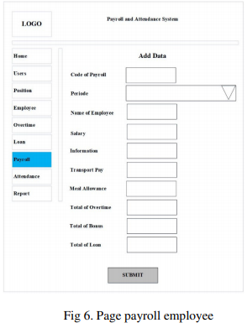
In the picture above explains that, admins have entered into the system and perform data management employee payroll is by entering some data into the data of employee name, meal money, transport money and others.

Slide 10
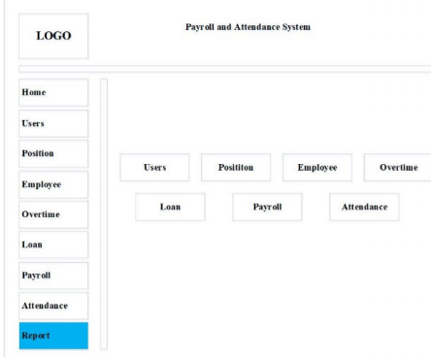
In the above view, explains that the leader can view reports on payroll data only, for other menus, the leadership cannot do it.

Slide 11
IV.CONCLUSION Payroll processing system employees at XYZ company that runs at this time still not utilize the IT media optimally. And the security aspect, that system runs so far have more deficiencies than the proposed system, such as the possibility for data to be corrupted, lost or altered. By using computerized payroll data processing application system is expected to assist in providing solutions to troubleshooting the current system. With digital storage such as using a database, excessive paper usage and archive storage can be resolved, so that faster work is done. With this payroll system, it can shorten the processing time of payroll data and reduce the problem of human error in the calculation of the salary of employees, can produce payroll reports quickly and accurately, expected payments can be accelerated, and there are restrictions on access rights to each user for avoiding unauthorized parties to access data freely.

